Slide 1
The re – evolution of the Mexico´s city Metro
PrÓXIMA ESTACIÓN…ESPERANZA

Slide 2

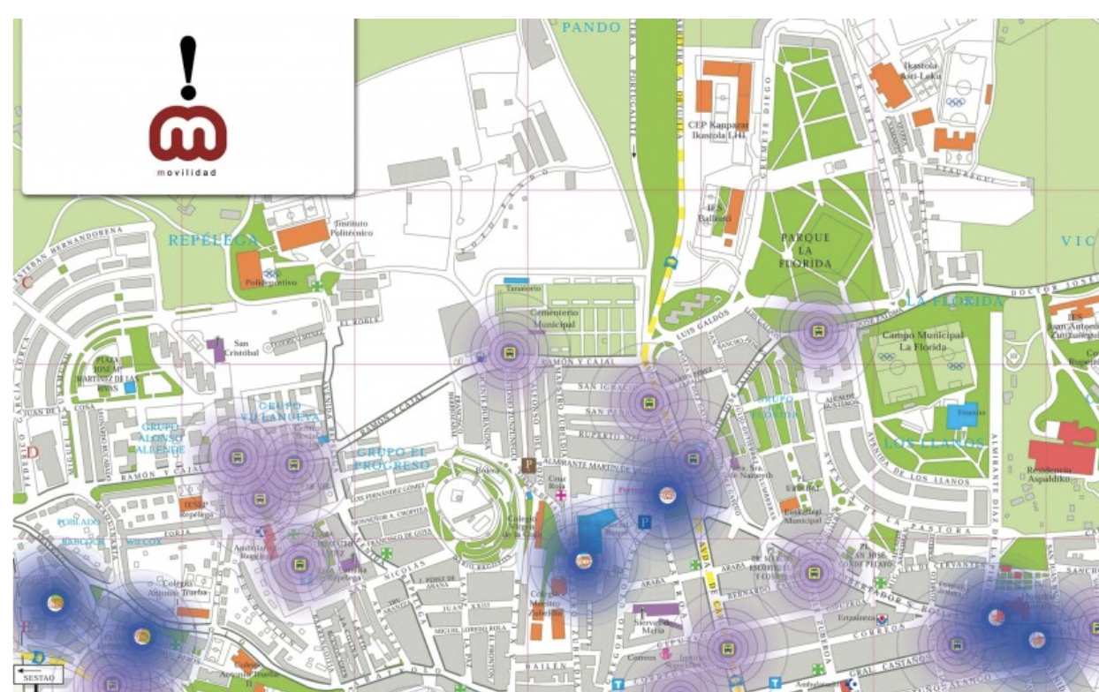
Here we are going to tell the story related with the mobility in MX city metro through recent years with a historical inflow graph
Here, the user can select the metro line, or station, to review which is the best option
We will be able to show a historical inflow graph right here

Slide 3
In september 4th from 1969, the Metro begins operations (Line 1) and now a day it has a 226 km extension, going from Mexico City to State of Mexico. It has become the backbone of mobility in the Metropolitan Zone of the Valley of Mexico. Each train, also called a convoy, is made up of nine cars. Six of them are drivers, that is, they have their own traction and they drag the convoy together; they occupy positions 1, 3, 4, 6, 7 and 9. The remaining trains are trailers, that is without their own traction. The body of the car, where passengers travel, is called a box. Every day, the Metro receives an average of 5.5 million people, number that exceeds the population of Uruguay by 2 million and amounts to the total population of Finland, for example. Let's imagine!!, 1 whole country traveling in the Metro is possible, and that happens day by day in the Valley of Mexico. Let´s review some numbers. In total there are 195 stations in the Metro. The deepest line is 7.

